Slide 1
DG Interns Hub — Week 3 Report
Linux Logs, Sysmon, auditd and Snort
Ghanisth Mittal
SOC monitoring • endpoint telemetry • Linux auditing • IDS detection • log analysis

Slide 2
Objectives
Collect and analyze Windows and Linux security telemetry.
Configure and validate Snort IDS rules.
Detect controlled network activity and map reconnaissance to MITRE ATT&CK T1046.
Practice SOC-style alert investigation through TryHackMe and LetsDefend.

Slide 3
Lab Environment & Rationale
Kali Linux + Metasploitable 2 were used as the isolated VMware network-security lab.
Kali served as the analyst/attacker workstation; Metasploitable 2 provided intentionally vulnerable services for authorized testing.
Windows was used separately for Sysmon endpoint logging.
This explains the practical choice instead of presenting the setup as if Ubuntu had been used.

Slide 4
Sysmon
Event ID 1 — process creation.
Event ID 3 — network connection activity.
Event ID 11 — file creation.
Captured Sysmon Operational Log and user-creation activity.
SOC value: process, network and file telemetry supports investigation and detection.

Slide 5
auditd
Verified auditd service was active.
Command: sudo ausearch -m EXECVE -ts recent
Observed command execution including ip addr show, ip tuntap show, grep, head and cut.
Command: sudo ausearch -m USER_AUTH -ts recent
Captured successful PAM authentication through /usr/bin/su.
USER_LOGIN returned no matches in the tested period; this was documented rather than fabricated.

Slide 6
Snort 3 Configuration
HOME_NET = 192.168.144.0/24
Included /etc/snort/rules/local.rules in the IPS configuration.
Validation: sudo snort -c /etc/snort/snort.lua -T
Result: configuration successfully validated with 0 warnings.

Slide 7
Snort Detection Rules
ICMP: verified custom 'ICMP Ping Detected' alert.
SSH: verified 'SSH Connection Attempt' against Metasploitable 2.
HTTP: connectivity verified, but custom HTTP alert was not reliably triggered.
T1046: SYN reconnaissance rule using detection_filter.

Slide 8
Specific Errors & Fixes
Snort 3 rejected the Snort 2-style 'threshold' keyword → changed to detection_filter.
ICMP rule direction changed from -> to <> to observe the required return traffic.
Self-SSH was not useful for remote evidence → tested against Metasploitable 2.
USER_LOGIN had no matching event → documented the result and used verified USER_AUTH evidence.

Slide 9
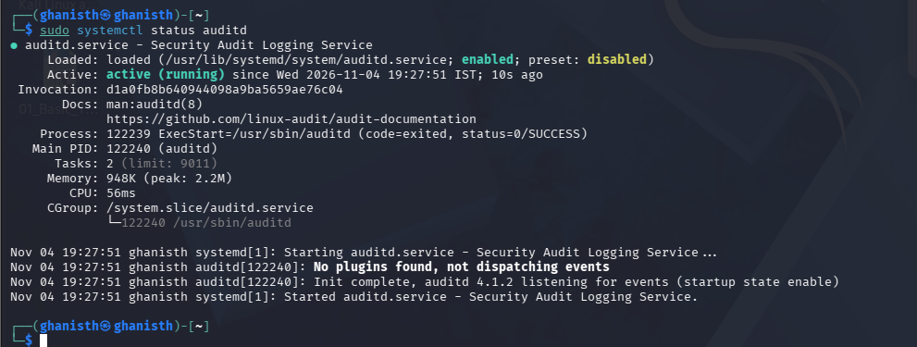
Evidence — auditd Service
auditd service shown as active (running).

Slide 10
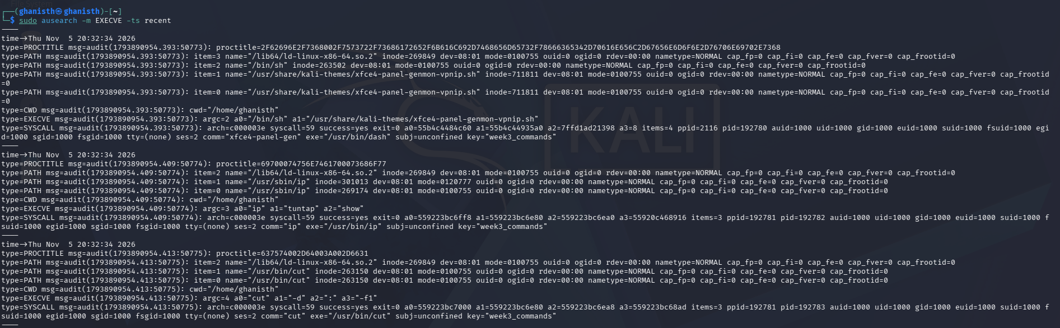
Evidence — auditd EXECVE
EXECVE telemetry showing command execution and key=week3_commands.

Slide 11
Evidence — auditd USER_AUTH
Successful PAM authentication evidence through /usr/bin/su.

Slide 12
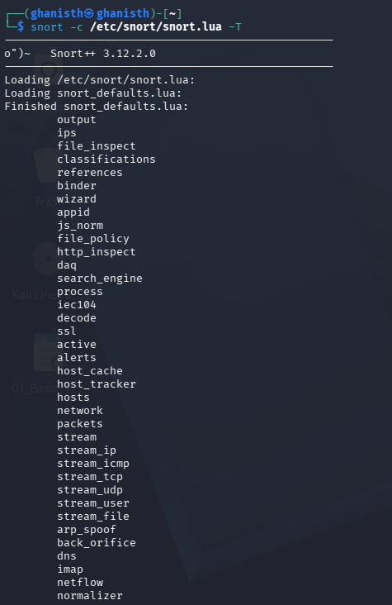
Evidence — Snort Validation
Snort 3 configuration successfully validated with 0 warnings.

Slide 13
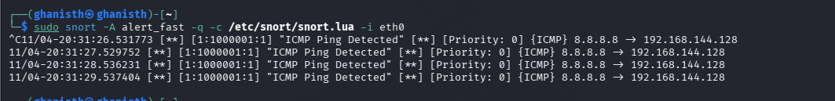
Evidence — Snort ICMP Alert
Custom ICMP Ping Detected alert.

Slide 14
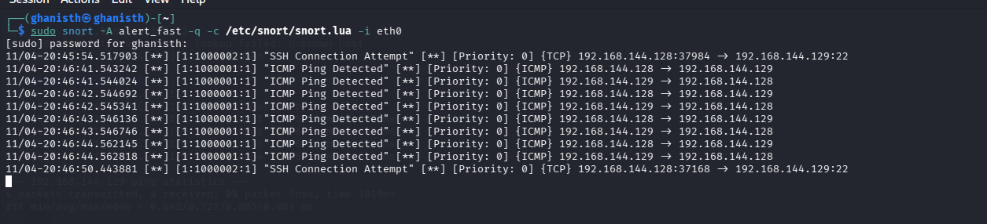
Evidence — Snort SSH / ICMP
SSH Connection Attempt and ICMP alerts involving Metasploitable 2.

Slide 15
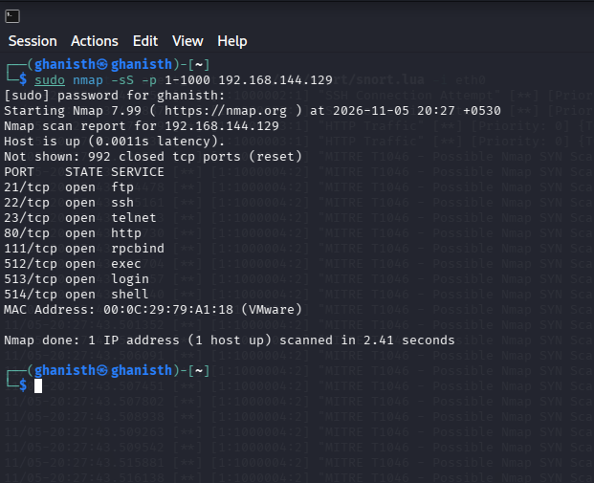
Evidence — Nmap Scan
Authorized Nmap SYN scan against 192.168.144.129.

Slide 16
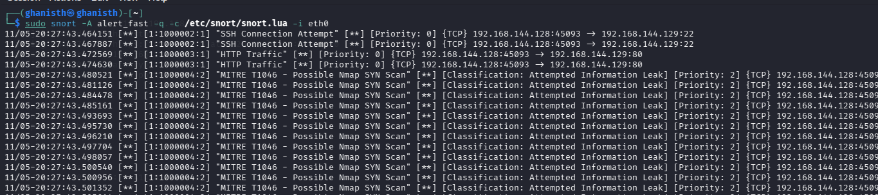
Evidence — MITRE T1046
Custom Snort rule generated T1046 reconnaissance alerts.

Slide 17
Nmap + MITRE ATT&CK T1046
Command: sudo nmap -sS -p 1-1000 192.168.144.129
Snort generated multiple SID 1000004 alerts for SYN scanning.
Detection mapped to T1046 — Network Service Discovery.
This demonstrates actual alert generation from controlled reconnaissance traffic.

Slide 18
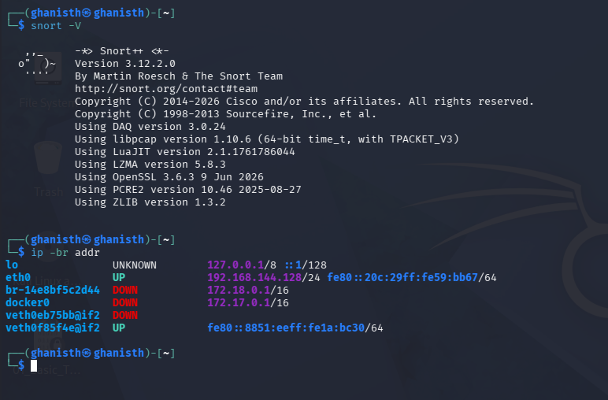
Evidence — Snort Version & Network
Snort 3.12.2.0 and Kali eth0 address 192.168.144.128/24.

Slide 19
Training Completed
TryHackMe: 4/4 rooms — Linux Logging for SOC, Intro to Logs, Intro to Log Analysis, Snort.
LetsDefend: 6/6 lessons — SIEM alert investigation, Security Solutions, Network Log Analysis, SIEM 101, Incident Management, Incident Response on Linux.

Slide 20

Evidence — LetsDefend Network Log Analysis
LetsDefend completion evidence.

Slide 21

Evidence — LetsDefend Security Solutions
LetsDefend completion evidence.

Slide 22

Evidence — LetsDefend SIEM 101
LetsDefend completion evidence.

Slide 23

Evidence — LetsDefend Incident Management
LetsDefend completion evidence.

Slide 24

Evidence — SIEM Alert Investigation
LetsDefend completion evidence.

Slide 25
Evidence & LinkedIn
Theory Q&A: 10 documents.
Findings: Sysmon, auditd, Snort, TryHackMe and LetsDefend evidence folders.
SOC Security Monitoring Cheat Sheet completed.
LinkedIn post published.
Submission form must contain the actual LinkedIn post URL, not only the profile URL.

Slide 26
Key Learning & Conclusion
SOC monitoring is evidence-driven: validate → generate controlled activity → observe telemetry → capture and analyze alerts.
Version differences matter: Snort 3 required detection_filter instead of the tested threshold syntax.
Good reporting separates verified detections from unsuccessful or unverified tests.
Week 3 strengthened practical skills across endpoint logging, Linux auditing, IDS detection and SIEM-style investigation.

